Slide 1
Fast and Faster
Wenhao He

Slide 2
Outline
CNN for Classification
RCNN for Object Detection
SPP Net and Fast RCNN
Faster RCNN
Comparisons of Four Models
Conclusion

Slide 3
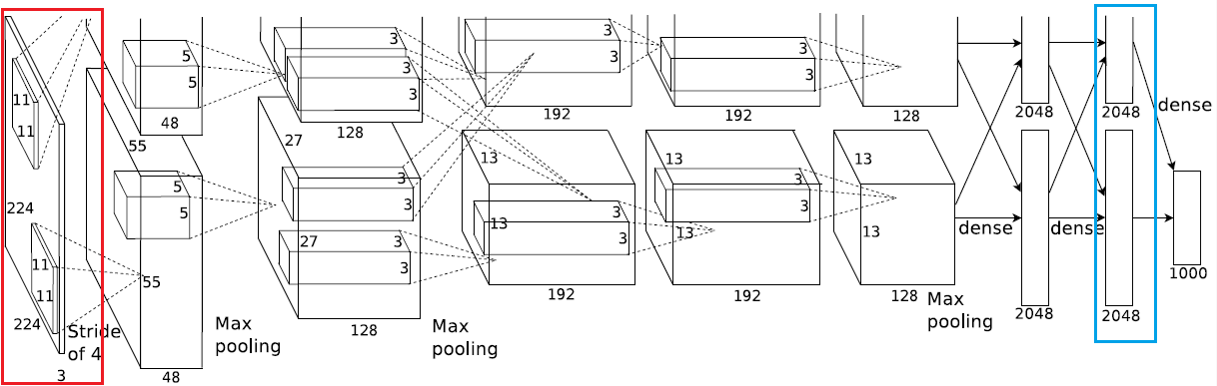
CNN
ImageNet Classification with Deep Convolutional Neural Networks
Input size is 224×224×3
Feature extracted is 1×4096

Slide 4

RCNN
Rich feature hierarchies for accurate object detection and semantic segmentation — 11 Nov 2013, CVPR 2014
Author: Ross Girshick

Slide 5
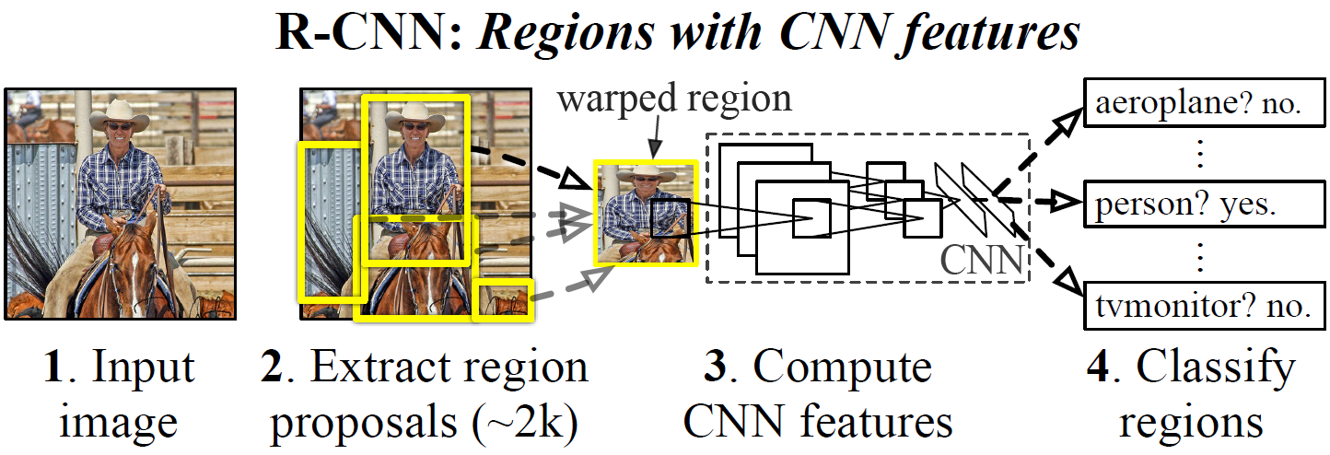
3 Steps
Generate proposals (Selective Search and Resize)
Extract CNN features from proposals
Region classification and regression

Slide 6
Generate Proposals
Generating category-independent region proposals
Examples include: objectness, selective search(Method Paper used), category-independent object proposals, constrained parametric min-cuts (CPMC), multi-scale combinatorial grouping, and Ciresan

Slide 7
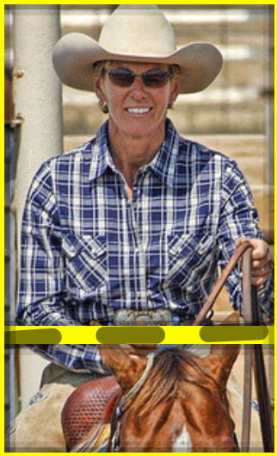
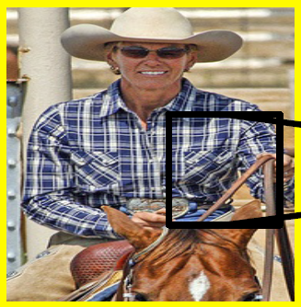
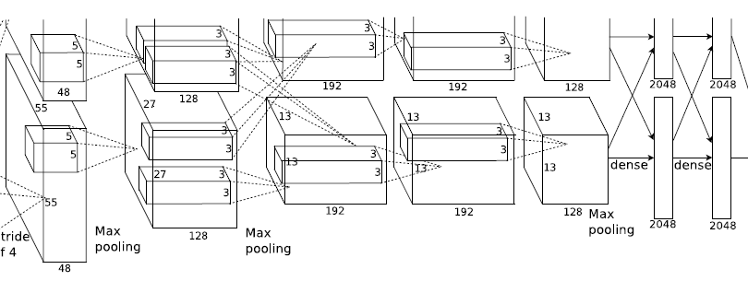
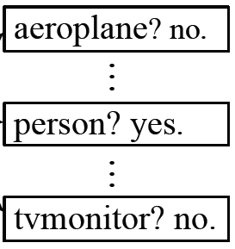
Get CNN Feature and Classify
Resize the image
Input resized image to CNN
Suppose we use AlexNet here, so the input size is 224×224×3, and we get feature of 1×4096
SVM is chosen here as the classifier, actually other classifiers are also OK
M×N proposal
224×224×3 proposal
AlexNet
1×4096 CNN feature
Traditional classifier

Slide 8

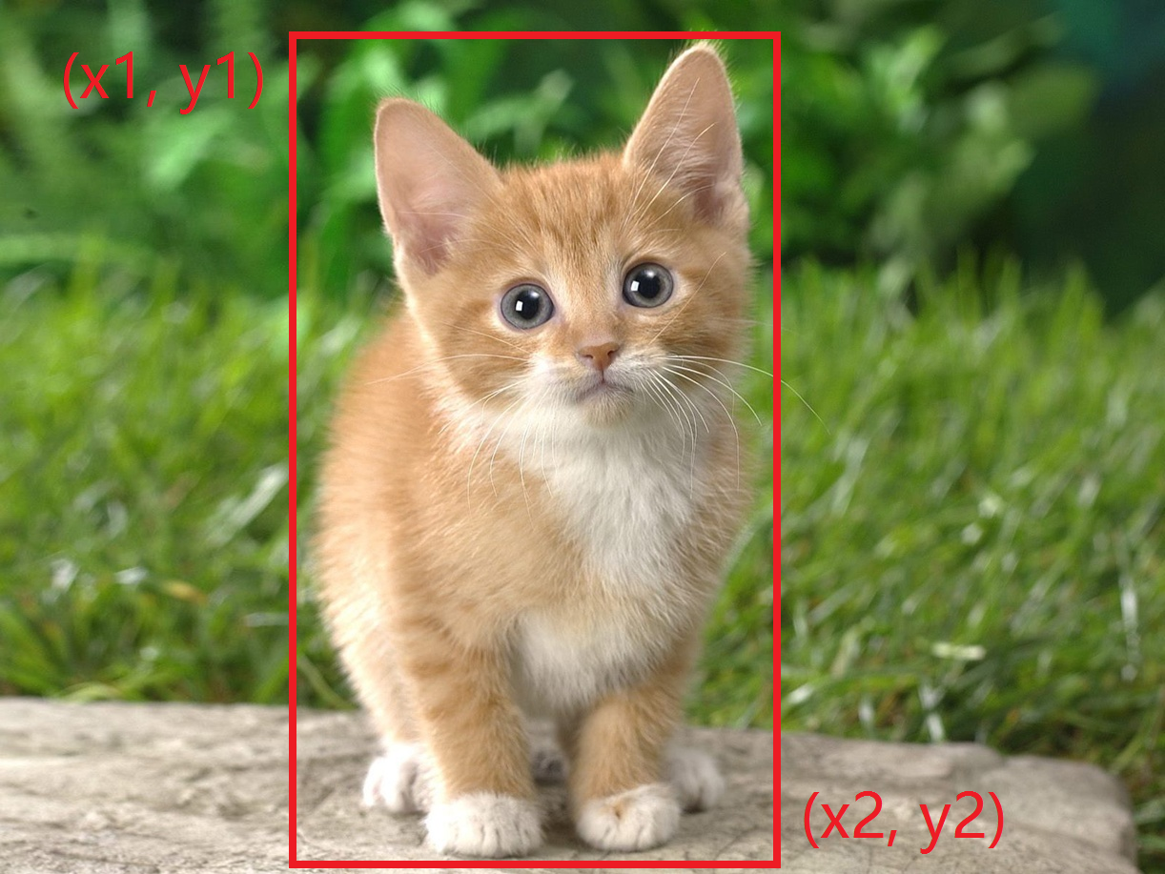
Region Regression (General Method)
Region regression is used here to refine the result as a post process
The ground truth is a vector G= (x1, y1, x2, y2)
The Feature Extractor output a vector P = (a1, b1, a2, b2)
Compute loss |G-P|_{α} and optimize the parameters
Predict vector
(x1, y1, x2, y2)
Notes:
回归在这里只是进一步优化框的位置
事实上，有很多的预测框的方法，这里只讲一个框架性的方法

Slide 9
SPPNet
Spatial Pyramid Pooling in Deep Convolutional Networks for Visual Recognition — 18 June 2014, ECCV 2014
Author: Kaiming He

Slide 10
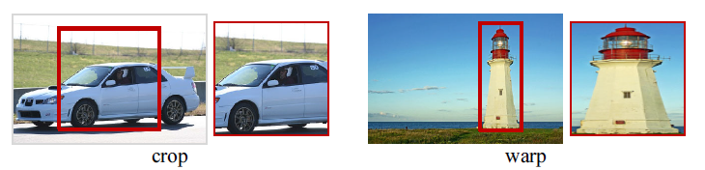
Could we design a better structure?
Resize proposal distort the feature
Crop proposal lose the feature
Notes:
为了让CNN能够处理提取的proposal，最直接的思路就是crop or warp

Slide 11
Could we design a better structure?
We introduce a spatial pyramid pooling: add an SPP layer on top of the last convolutional layer and generates fixed-length outputs

Slide 12

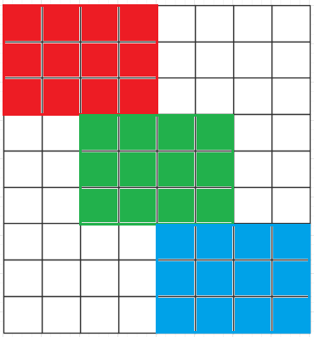
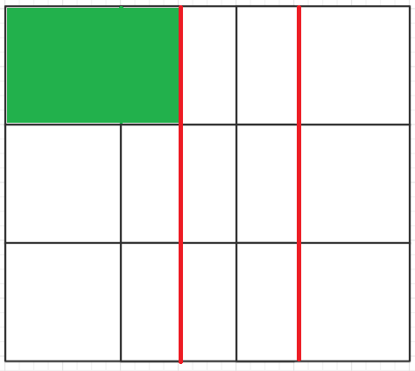
Spatial Pyramid Pooling
Suppose we get a N×M feature map
N, M are not fixed for unfixed input size
To get a fixed feature of a × a, we crop the feature map by window ≈ N/a × M/a with stride ≈ N/a × M/a

Slide 13

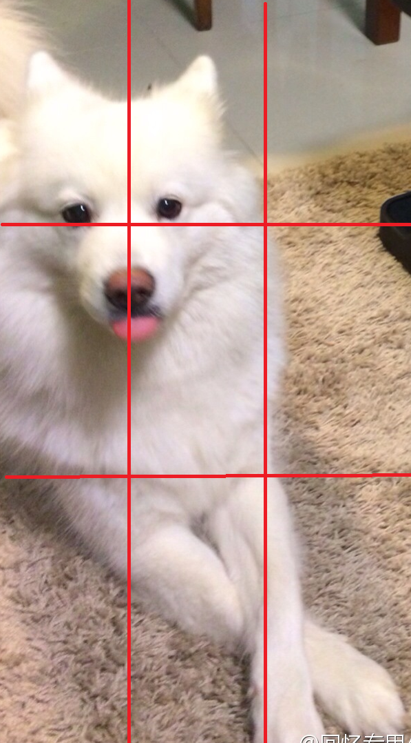
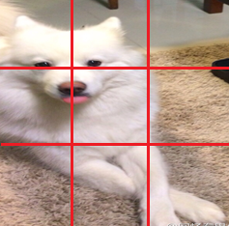
Rationality of SPP
Notes:
给人的感觉是把resize的过程放到了后面了（这个观点在后面的论文Fast RCNN中也有提到），好不好还是要看结果

Slide 14
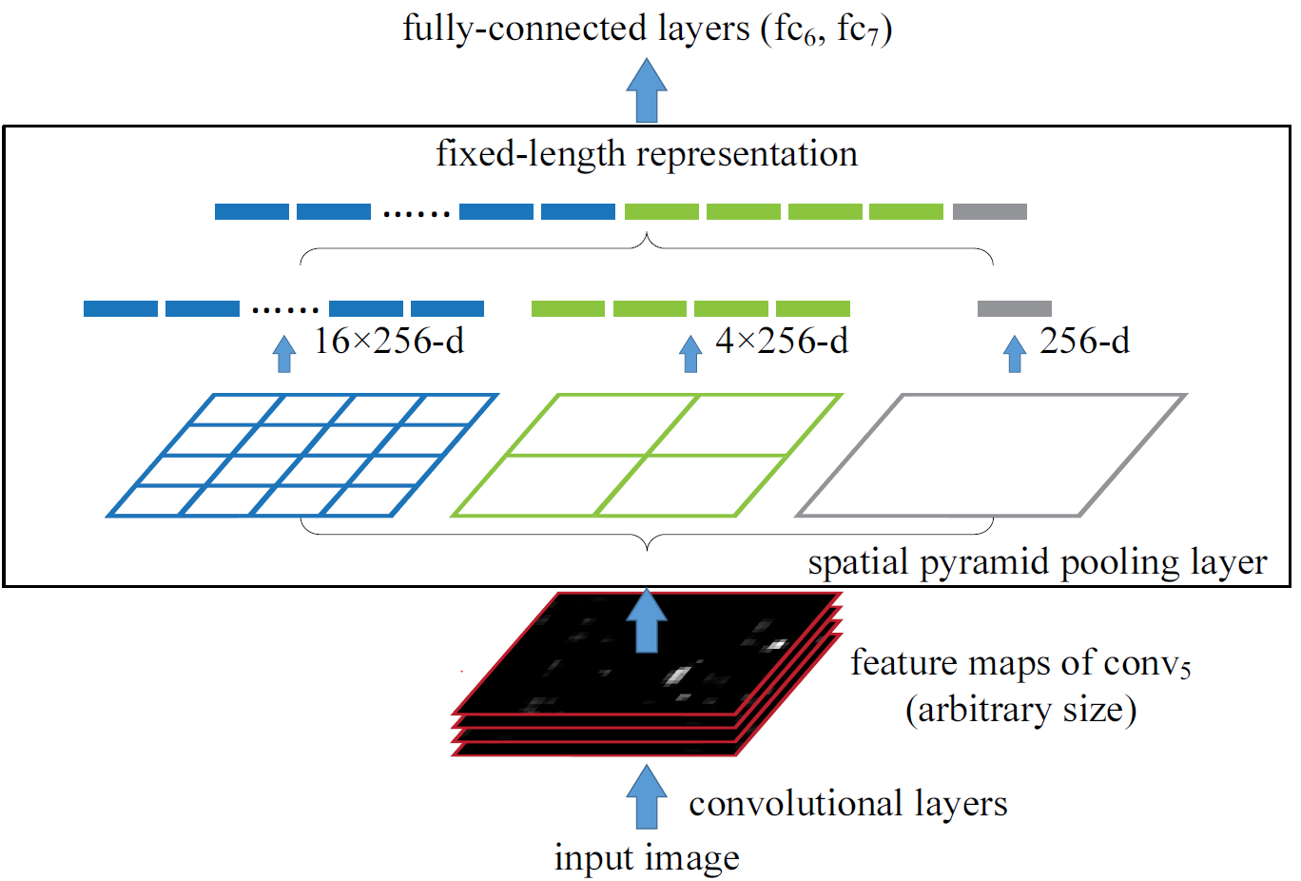
SPPNet Structure
Various resolution proposals
Notes:
如果是做检测是需要加入提取proposal的步骤的
所以说这个结构训练的时候是不能整体训练的，因为如果要训练fc67，输入就会变分辨率，对于caffe来说不支持

Slide 15
Fast R-CNN
Fast R-CNN — 30 Apr 2015 (v1), ICCV 2015
Author: Ross Girshick
One word to conclude
Single scale version of SPPNet

Slide 16
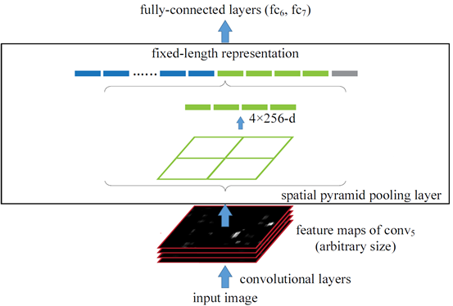
SPPNet Fast-RCNN
Notes:
一个最直观的解释，当然真正的实现细节有所不同

Slide 17
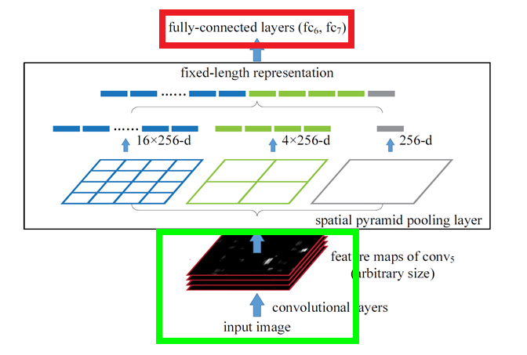
Other Improvements
Train the net as a whole
In SPPNet, convolution layers’ parameters are pre-trained and fixed. Only fc6 and fc7 are trained
Notes:
在训练检测的任务中，绿色框的参数是不动的
红框代表fine-tuning的layers
绿框代表pre-train之后保持不动的layers

Slide 18
Other Improvements
Train the net as a whole
Actually, SPPNet can also be trained together theoretically, but Caffe require fixed input size
In Fast RCNN, all the parameters can be trained together
Proposals are not cropped — RoI pooling layer
In SPPNet and RCNN, proposals are cropped making inputs have various resolutions
In FastRCNN, proposals are not cropped but only gives bounding boxes information

Slide 19
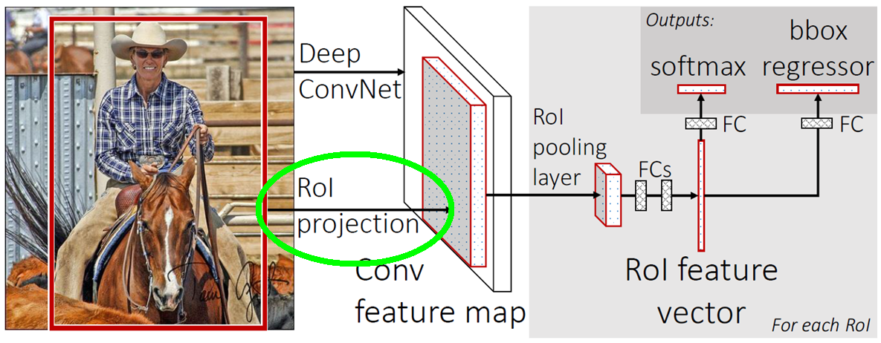
Other Improvements
Notes:
如果被问起细节就解释下吧，一张图含有多个Proposals，那么RoI后面就有多个Proposal的特征，也就是说 num这一维大小是RoI的个数，然后把这些个RoI的特征作为一个batch训练，当然会有细节，比如各种Centric Sampling什么的，都是为了提高效果用的

Slide 20
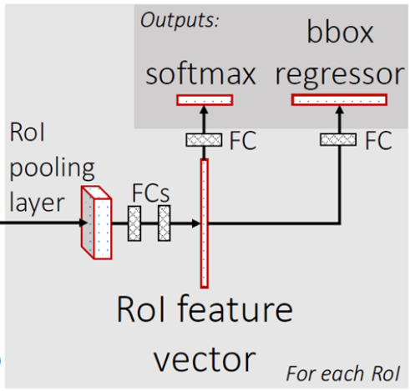
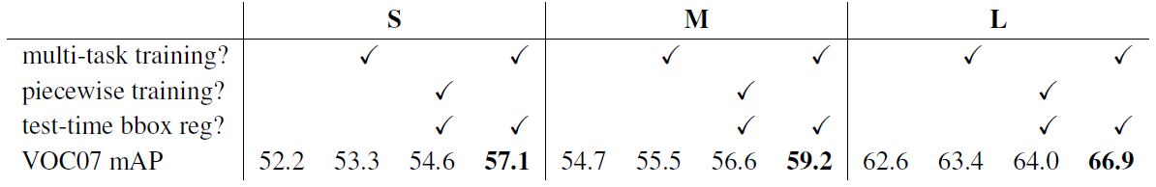
Other Improvements
Multi-task learning
In RCNN, regression is done separately
In Fast RCNN, regression is one of the training tasks
Notes:
Piecewise 意思是分开训练
Test-time bbox reg假如是false的话意思就是用selective search给的proposal的位置作为测试的输出结果

Slide 21
Faster RCNN
Faster R-CNN: Towards Real-Time Object Detection with Region Proposal Networks — 4 June 2015, NIPS 2015
Authors: Shaoqing Ren, Kaiming He, Ross Girshick, Jian Sun

Slide 22
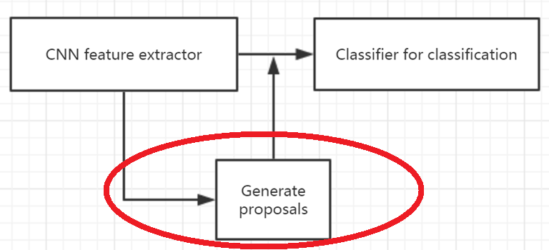
Background
Region proposal computation is a bottleneck
If we have a branch to predict proposals using shared features with classification, system will be much more efficient

Slide 23
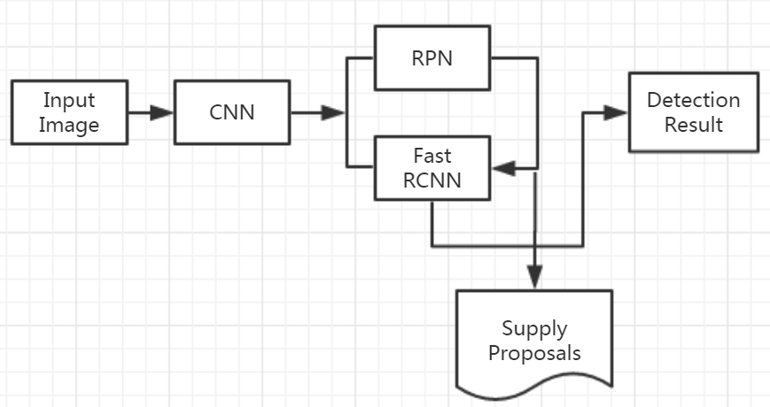
Faster RCNN

Slide 24
How to train it
RPN and Fast RCNN are trained independently and modify their conv layers in different ways
Fast R-CNN training depends on fixed object proposals
Joint optimizing is an interesting question for future work
we develop a pragmatic 4-step training algorithm to learn shared features via alternating optimization
Notes:
我怎么感觉可以联合训练啊

Slide 25
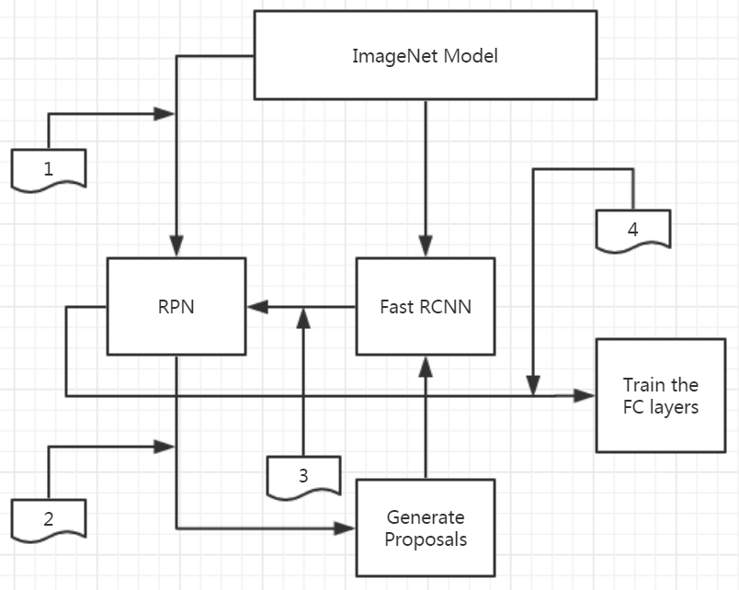
4-step training algorithm
Notes:
Fc layers就是预测score跟box的

Slide 26
4-step training algorithm
Train the RPN
Fine-tuned from an ImageNet pre-trained model
Train a separate detection network by Fast R-CNN using the proposals generated by the step-1 RPN
Fine-tuned from the same ImageNet pre-trained model
Use the detector network to initialize RPN training, but we fix the shared conv layers and only fine-tune the layers unique to RPN
Then two networks share the conv layers
Keeping the shared conv layers fixed, we fine-tune the fc layers of the Fast R-CNN

Slide 27
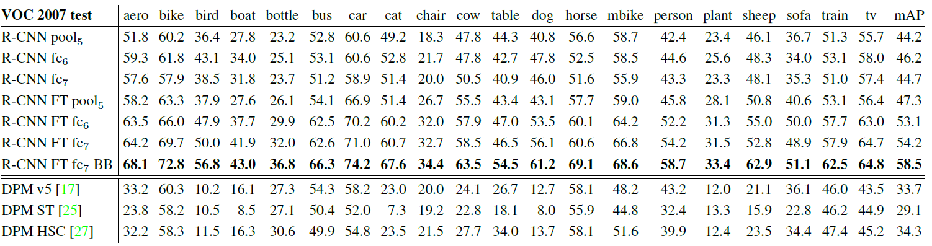
Results Comparison
Datasets
PASCAL VOC 2007
RCNN and other methods

Slide 28
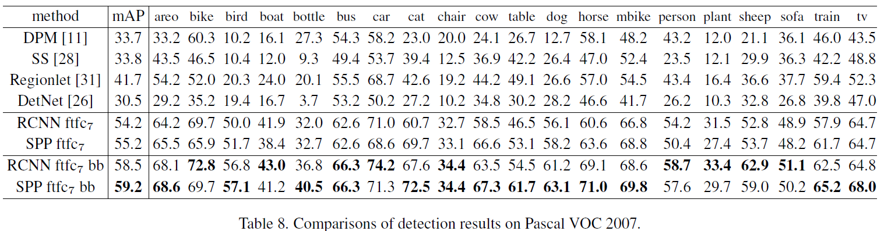
Results Comparison
SPPNet

Slide 29
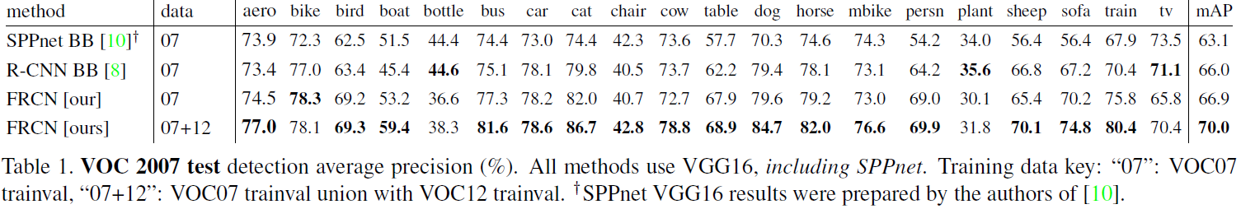
Results Comparison
Fast RCNN

Slide 30
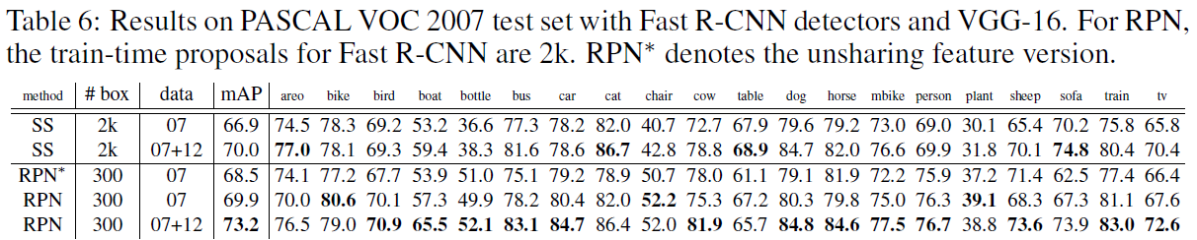
Results Comparison
Faster RCNN

Slide 31
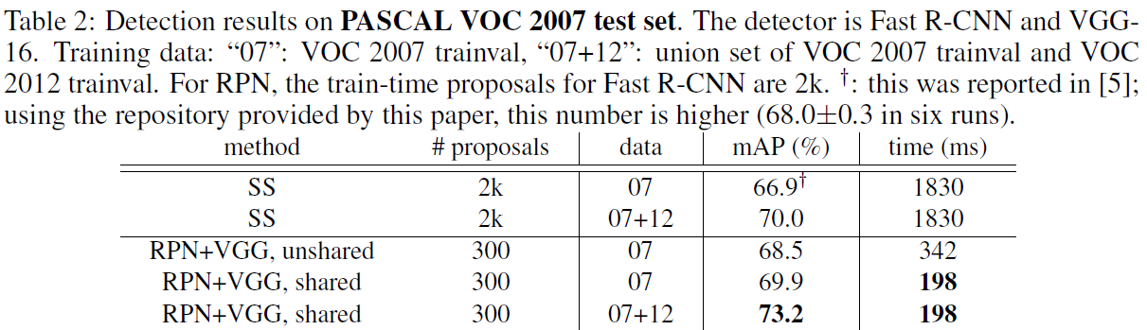
Results Comparison
Time comparison
Fast and Faster

Slide 32
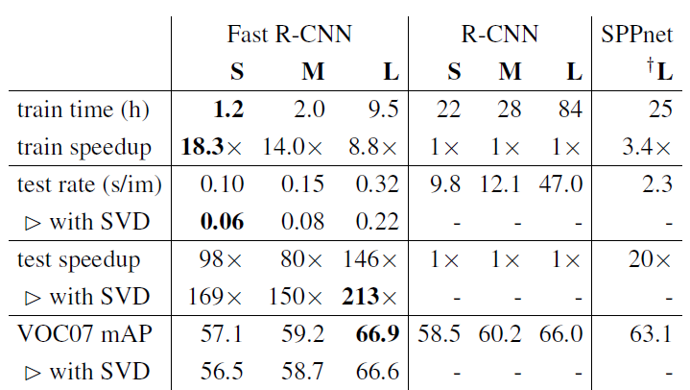
Results Comparison
Time comparison
Fast and RCNN SPPNet
Notes:
SVD是加速fc网络的

Slide 33
Conclusion
Introduced the development of RCNN model
Four state of the art results
From fast to faster
Pipelines are reduced
Train and test processes both grow faster
Require much less memory

Slide 34
Q&A

